Slide 1
Hospital Database Management System
1

Slide 2
Table of contents
01
02
03
04
Overview
(Page 4)
ERD Diagram
(Page 5)
Triggers & Sequences
(Page 6)
05
Queries
(Page 10)
Challenges
(Page 11)
2

Slide 3
Project Overview
Purpose:
Hospital management system project is an important investment for healthcare providers looking to improve the quality and efficiency of their operations. With the right system in place, hospitals can better manage patient care and financial operations, leading to more sustainable business model for the hospital.
Scope:
The hospital management system is designed to manage and streamline the operations of a hospital or medical centre. The system can help healthcare providers manage doctor, patient records, appointments, prescriptions, bills as well as other important aspects of hospital operations.
4

Slide 4
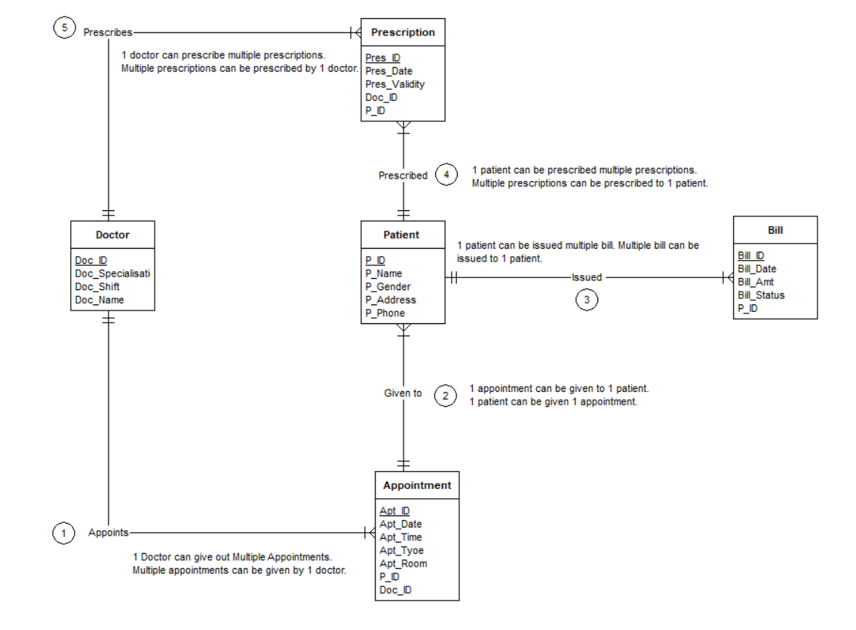
ERD Diagram
5

Slide 5
Entity Description and Relations
1. Doctor- Describes Doctors working in the hospital.
Attributes :
Doc_ID(PK)(Int) #Primary Key
Apt_ID(FK)(Int) #Foreign Key referencing Appointment Entity
Doc_Name(varchar) #Name of Doctor
Doc_Specialisation(varchar) #Specialisation of the Doctor
Doc_Shift(Date) #Date of Doctors shift
2. Patient- Details of the patients visiting the hospital.
Attributes:
P_ID(PK)(Int) #Primary Key
Apt_ID(FK)(Int) #Foreign Key referencing Appointment Entity
P_Name(varchar) #Name of the patient
P_Gender(varchar) #Gender of the patient
P_Address(varchar) #Address of the patient
P_Phone(Int) #Phone number of the patient

Slide 6
Entity Description and Relations
3. Appointment- Describes appointments given to patients.
Attributes:
Apt_ID(PK) (Int) #Primary Key
P_ID(FK)(Int) #Foreign Key referencing to patient Entity
Apt_Date(Date) #Date of the appointment
Apt_Time(Time) #Time slot of the appointment
Apt_Type(varchar) #General Consultation or specialised appointment
Apt_Room(Int) #Designated room number
4. Prescription- Describes prescriptions written by doctor to patient.
Attributes:
Pres_ID(PK)(Int) #Primary Key
Doc_ID(FK)(Int) #Foreign Key referencing Doctor Entity
P_ID(FK)(Int) #Foreign Key referencing Patient Entity
Pres_Date(Date) #Date of prescription given
Pres_Validity(Date) #Date till validity of prescription

Slide 7
Entity Description and Relations
. 5. Bill- Describes bill generated by hospital to patient.
Attributes:
Bill_Id(PK)(Int) #Primary Key
P_ID(FK)(Int) #Foreign Key referencing Patient Entity
Bill_Date(Date) #Date of bill generated.
Bill_Amt(Int) #Amount of bill
Bill_Status(varchar) #Status whether Paid or Unpaid

Slide 8
Business Rules
1) DOCTOR - APPOINTMENT 1 : M
1 Doctor can give out Multiple Appointments.
Multiple appointments can be given by 1 doctor.
2) APPOINTMENT - PATIENT 1 : 1
1 appointment can be given to 1 patient.
1 patient can be given 1 appointment.
3) PATIENT - BILL 1 : M
1 patient can be issued multiple bill.
Multiple bill can be issued to 1 patient.
4) PATIENT - PRESCRIPTION 1 : M
1 patient can be prescribed multiple prescriptions.
Multiple prescriptions can be prescribed to 1 patient.
5) DOCTOR - PRESCRIPTION 1 : M
1 doctor can prescribe multiple prescriptions.
Multiple prescriptions can be prescribed by 1 doctor.
6) DOCTOR - PATIENT 1 : M
1 doctor can be appointed to multiple patients.
Multiple patients can be appointed to 1 doctor.

Slide 9
Sequences
Create a sequence to generate unique doc_id values
CREATE SEQUENCE doc_id_seq
INCREMENT BY 1
START WITH 1
MINVALUE 1
NO MAXVALUE
CACHE 1;
6

Slide 10
Triggers
Create a trigger to automatically set doc_id
before insert
CREATE OR REPLACE FUNCTION set_doc_id()
RETURNS TRIGGER AS $$
BEGIN
-
- If doc_id is not provided, set it to the next value from the sequence
IF NEW.doc_id IS NULL THEN
NEW.doc_id := nextval('doc_id_seq');
END IF;
RETURN NEW;
END;
Attach the trigger to the doctors table
CREATE TRIGGER
set_doc_id_trigger
BEFORE INSERT ON doctors
FOR EACH ROW
EXECUTE FUNCTION set_doc_id();

Slide 11
Queries
List the details of patients with total unpaid and paid bills who have an appointment with a doctor's name starting with M.
With Patient_list AS
( SELECT
DISTINCT P.P_ID,
P.P_Name,
P.P_Gender,
P.P_Address,
P.P_Phone from appointment A
JOIN
patient P on P.P_ID = A.P_ID
JOIN doctor D on D.Doc_ID = A.Doc_ID Where Doc_name like ‘M%’)
SELECT DISTINCT B.P_ID, PL.P_Name, PL.P_Gender, PL.P_Address, P.P_Phone, SUM( CASE WHEN B.bill_status = ‘paid’ then B.bill_amount else null end ) as total_paid_amount, SUM(CASE WHEN B.bill_status = ‘unpaid’ then B.bill_amount else null end)
as total_unpaid_amount FROM bill b
JOIN Patient_list PL on PL.P_ID = B.P_ID
GROUP BY B.P_ID, PL.P_Name, PL.P_Gender, PL.P_Address, P.P_Phone
8

Slide 12
Queries
List the details of doctors who have appointments with patients with maximum and minimum bills
With patient_total_bill AS (SELECT DISTINCT P_ID, SUM(bill_amount) as total_bill, FROM bill
Group by P_ID ), max_min_bill as (SELECT MAX(total_bill) as max_bill,
MIN(total_bill) as min_bill
FROM patient_total_bill),
Patient_list AS
(SELECT
DISTINCT P_ID
FROM patient_total__bill
WHERE (total_bill = (select max_bill from_max_min_bill)
OR
(total_bill = (select min_bill from_max_min_bill)))
SELECT
DISTINCT D.Doc_id,
D.Doc_Name,
D.Doc_Specialisation,
D.Doc_Shift,
D.Doc_Professional_Experience
FROM Appointment A
JOIN Doctor D on D.doc_id = A.doc_id
WHERE A.P_ID in (select distinct P_ID from patient_list)
8

Slide 13
Challenges
Data Security and Compliance: Ensuring patient data security and compliance with healthcare regulations.
Data Integrity: Maintaining accurate and consistent data through proper constraints.
Complex Data Relationships: Designing a relational database schema that accurately represents intricate relationships between entities.
Concurrency Control: Implementing mechanisms to handle simultaneous data access and updates.
9

Slide 14
Thank you

